Slide 1
Automated Peak Detection Information Slides
By Aleksander Berezowski

Slide 2
General Process
Read CSV Array
For each row in CSV Array
Clean data via 4 different filters
Find peaks via scipy peak detection using prominence
Find valleys via scipy peak detection using prominence
Return peaks and valleys

Slide 3
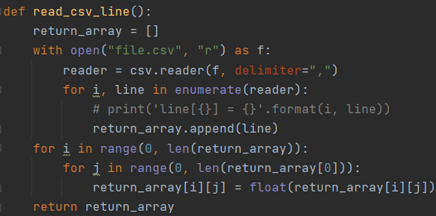
Read CSV Array
Standard python to read a CSV array
2D array
Each line of the file is an array
Inner arrays contains the values delimited via a comma

Slide 4
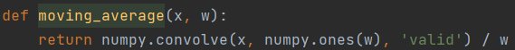
Clean data different filter
Linear Moving Average Filter
Exponential Moving Average Filter
Geometric Moving Average Filter
Fourier Filter

Slide 5
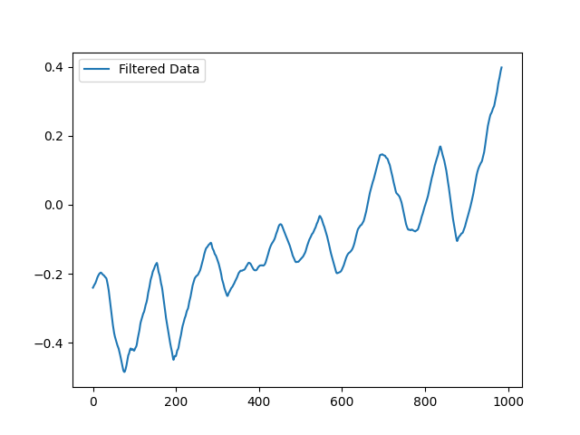
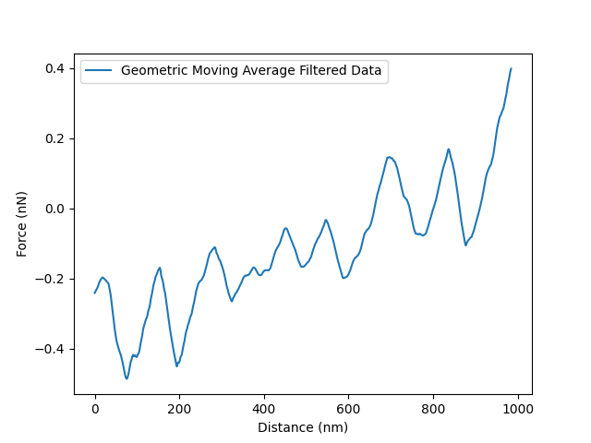
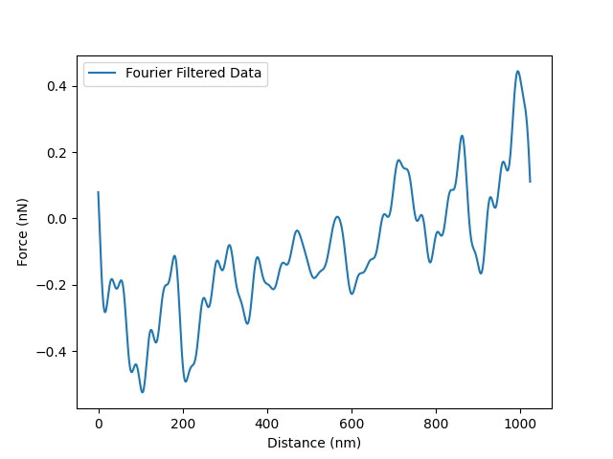
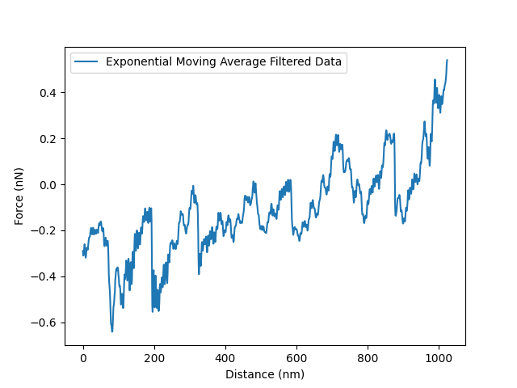

Slide 6
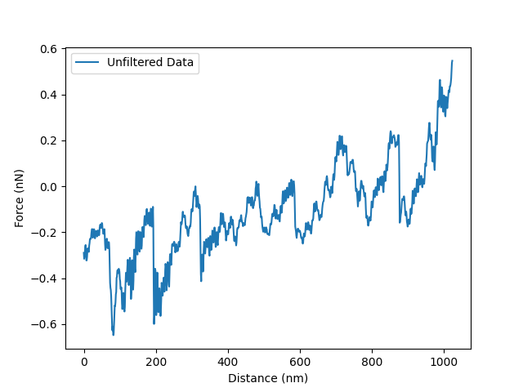
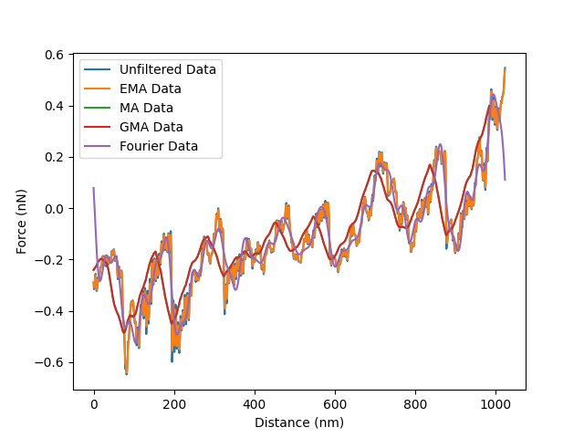

Slide 7
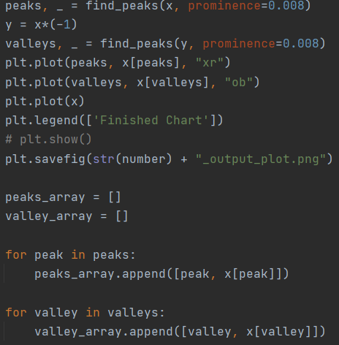
Find peaks / valleys via scipy peak detection using prominence
Scipy package makes it easy
“The prominence of a peak measures how much a peak stands out from the surrounding baseline of the signal and is defined as the vertical distance between the peak and its lowest contour line.”

Slide 8
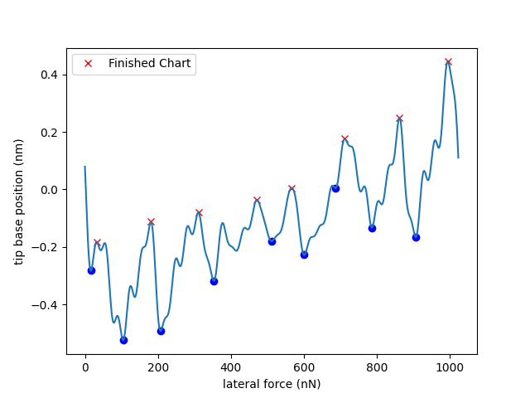
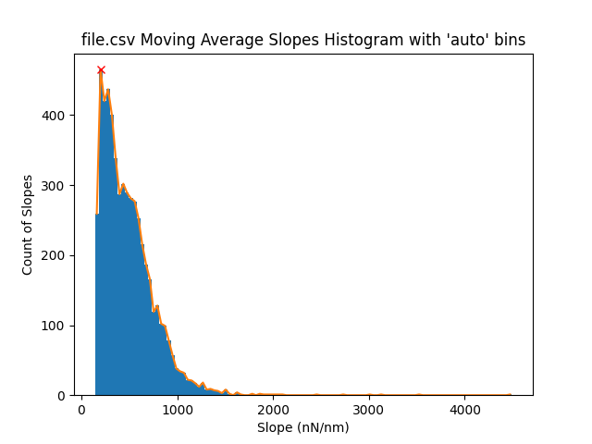
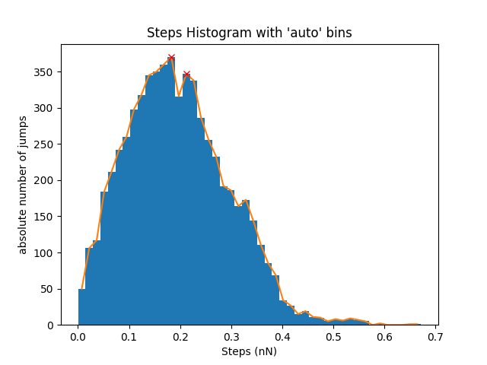
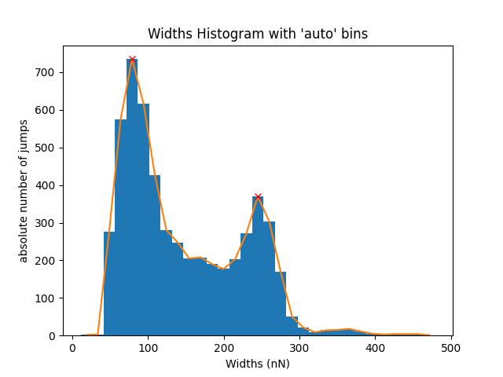
Linear Moving Average Filter

Slide 9
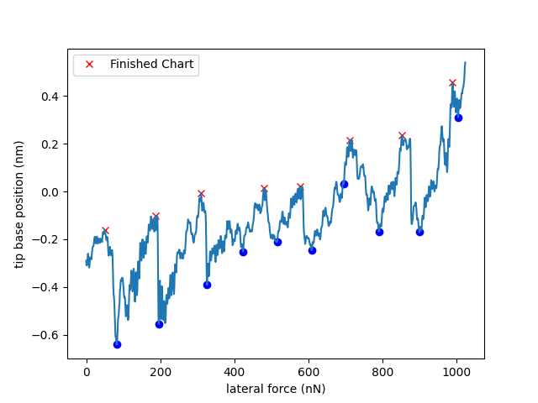
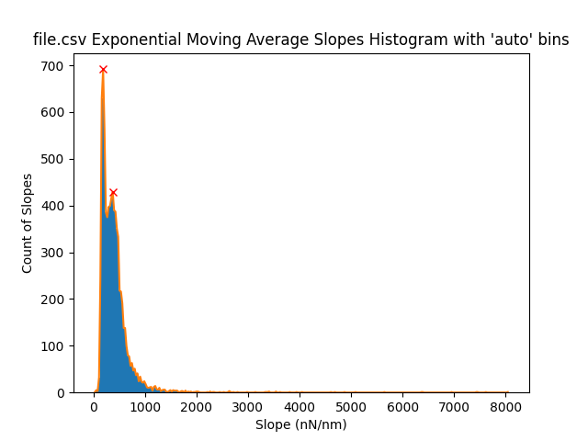
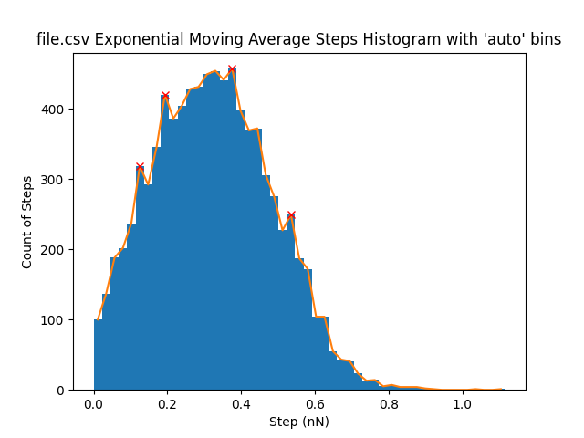
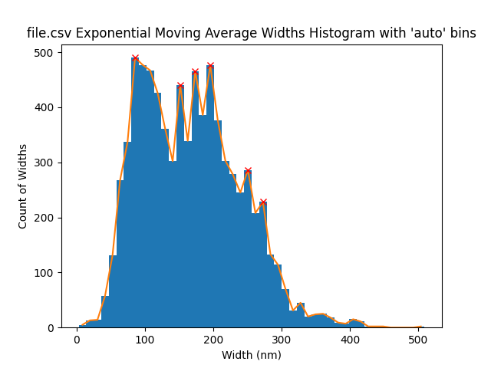
Exponential Moving Average Filter

Slide 10
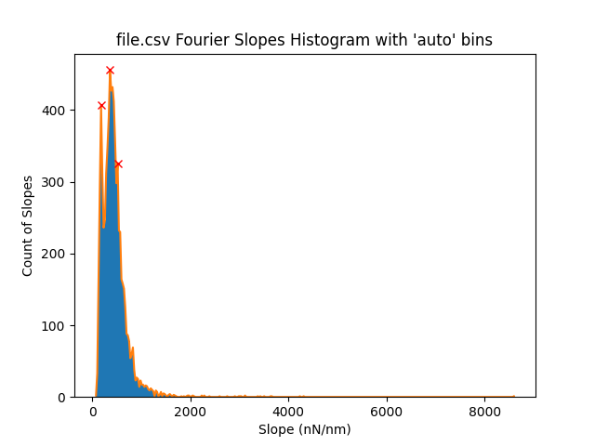
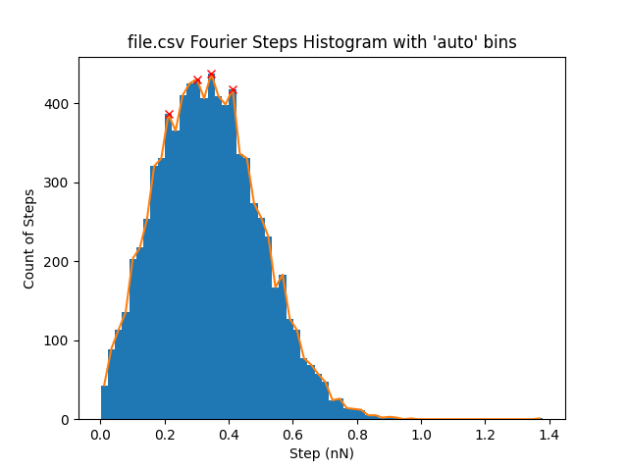
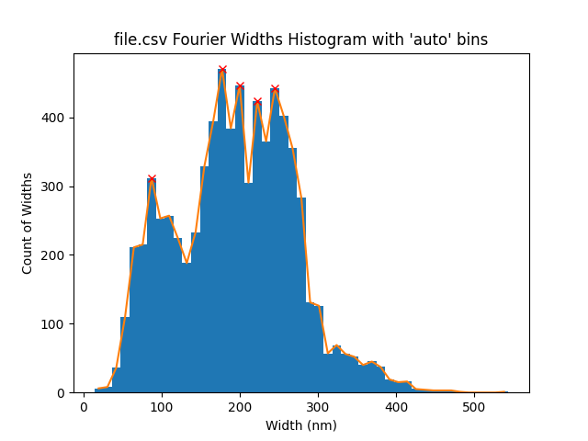
Fourier Filter

Slide 11
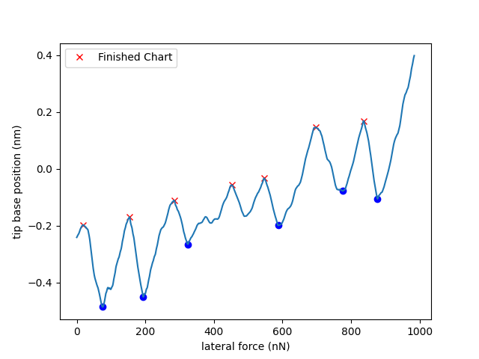

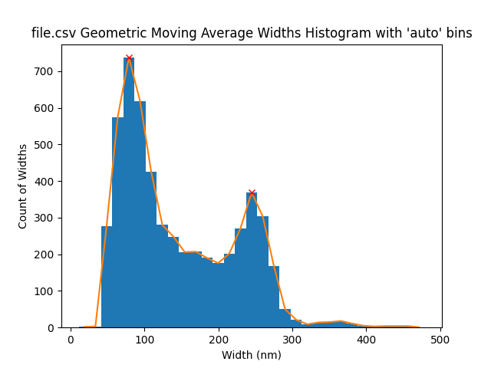
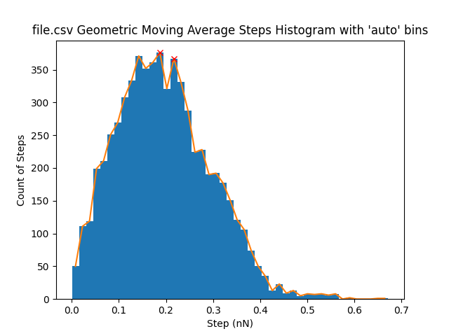
Geometric Moving Average Filter

Slide 12
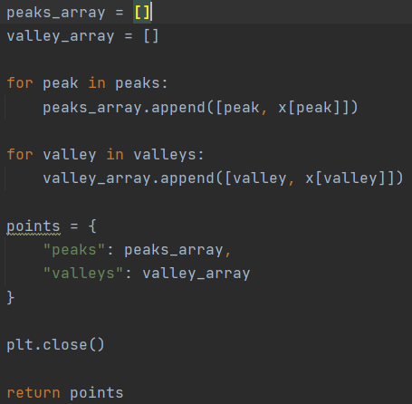
Return peaks and valleys
Put data for peaks and valleys into separate arrays
Return arrays in dictionary for use

Slide 13
Project Link with More Information: https://github.com/thesixtium/AFM_Peak_Detection

